Slide 1
Bridge Condition Assessment and Deterioration Analysis
Greeshma Priya Pendyala
Jaswanth Malla
Manohar Babu Katika
Sri Ram Jawahar Vennala
Uday Sai Bela
Team - 5
Dr. Lindi Liao
GEORGE MASON UNIVERSITY
AIT 614-001: Big Data Essentials
19th November 2024

Slide 2
Introduction:
Bridges are crucial to transportation infrastructure, connecting communities and facilitating efficient movement of goods and people. Aging infrastructure, increasing traffic, and environmental factors often contribute to bridge deterioration over time. To ensure safety and longevity, continuous monitoring, maintenance, and timely intervention are essential.
The Bridge Condition Assessment and Deterioration Analysis project leverages data-driven techniques to analyze factors impacting bridge health. Utilizing the variables such as age, traffic volumes, construction materials, and structural designs, this study aims to develop predictive models to forecast bridge conditions and identify risks.
This initiative seeks to understand key determinants of bridge deterioration and assist agencies in prioritizing maintenance efforts through risk-based assessments. The goal is a proactive approach to bridge management, minimizing costs, enhancing safety, and ensuring sustainable infrastructure.

Slide 3
Objective:
The "Bridge Condition Assessment and Deterioration Analysis" project aims to use machine learning to predict bridge conditions based on traffic loads, material properties. It focuses on analyzing key deterioration factors, such as age and structure, to generate actionable maintenance recommendations. The project evaluates the impact of traffic categories and structural designs on deterioration rates and develops a decision-making framework for optimizing maintenance strategies. Ultimately, it seeks to enhance bridge health monitoring and infrastructure management.

Slide 4
Summarized Project timeline:
TASK | TIMELINE | TASK ACCOMPLISHED BY
Data selection & Project Topic | 10/10/2024 | All Members
Project Proposal | 10/22/2024 | All Members
Setting Up Environment | 11/3/2024 – 11/6/2024 | Greeshma Priya, Uday Sai, Manohar Babu
Model Planning & Model Building | 11/7/2024 – 11/9/2024 | Sri Ram Jawahar, Manohar Babu, Jaswanth, Greeshma Priya
Recording & Presenting Findings | 11/10/2024-11/15/2024 | Uday Sai, Jaswanth, Sri Ram Jawahar
Presentation Slides & Project Abstract | 11/19/2024 | All Members
Class Presentation | 11/20/2024 | All Members
Project Working System | 11/26/2024 | All Members

Slide 5
Selected Dataset:
The proposed dataset for "Bridge Condition Assessment and Deterioration Analysis" includes key features such as State Code, Structure Number, and Owner Agency for tracking and management. It provides geographic context with County Code, County Name, and City - InfoBridge Place Name. Structural details like Year Built, Main Span Material, and Structure Length inform durability assessments. Traffic impact is measured through Average Daily Traffic (ADT) and Deck Area. Finally, Bridge Condition (CAT10) and Bridge Age offer insights into the current state and maintenance needs of the bridges
The Number of Rows in dataset are: 59501.
The Number of Columns in dataset are: 17

Slide 6
Average Daily Traffic (ADT): The average number of vehicles that pass over the bridge each day, which helps assess traffic load and its impact on bridge conditions.
Main Span Material: The primary material used in the construction of the bridge's main span (e.g., steel, concrete), which can influence durability and maintenance needs.
Main Span Design: The design type of the bridge's main span (e.g., arch, beam, suspension), which affects its structural performance and load-bearing capacity.
Structure Length (ft.): The total length of the bridge in feet, providing a measure of its size and scale.
Bridge Condition (CAT10): A categorical assessment of the bridge's condition, indicating its overall health and need for maintenance or repair.
Bridge Age (yr): The age of the bridge calculated from the year built, which can correlate with deterioration and maintenance needs.
Deck Area (sq. ft.): The total area of the bridge deck in square feet, relevant for evaluating the bridge's capacity to handle traffic loads.

Slide 7
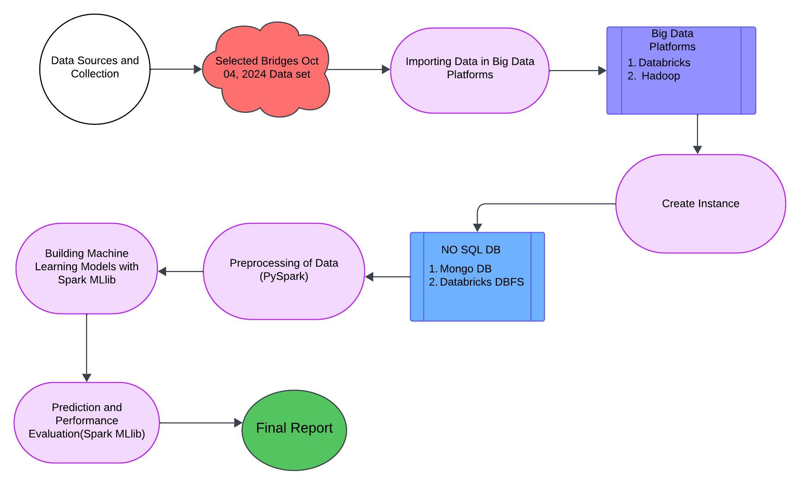
The System:
Software/Hardware Platforms:
Windows 11
DataBricks DBFS
Spark with Python
Spark with Mllib
Databricks

Slide 8
Data Preprocessing:
Handled missing values by imputing them mean and removed duplicates, and corrected the inconsistencies in the data, and identified outliers using methods like IQR, Percentile.
Used statistical and machine learning techniques to identify and remove or cap outliers that could distort analysis or models.
Predicted the bridge deterioration based on traffic volume using the DBFS, Pyspark,Mlib

Slide 9
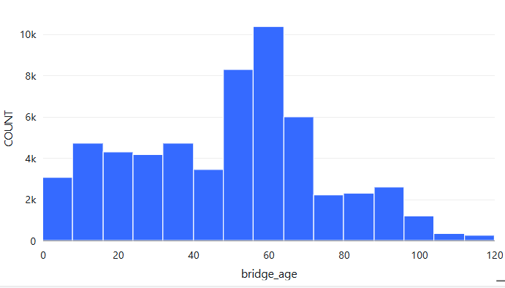
Experimental Results and Analysis
The x-axis represents the age of the bridge in years, and the y-axis represents the count of bridges in each age. The majority of bridges in the data are between 50 and 70 years old.
Distribution of Bridge Ages

Slide 10
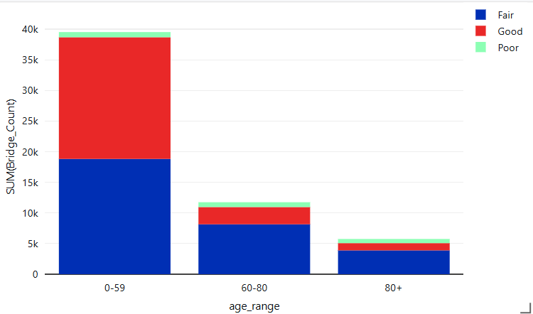
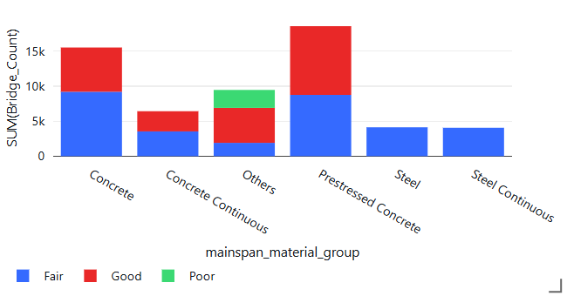
Bridge Count By Age Range and Condition
Bridge Condition Distribution By Main Span Material

Slide 11
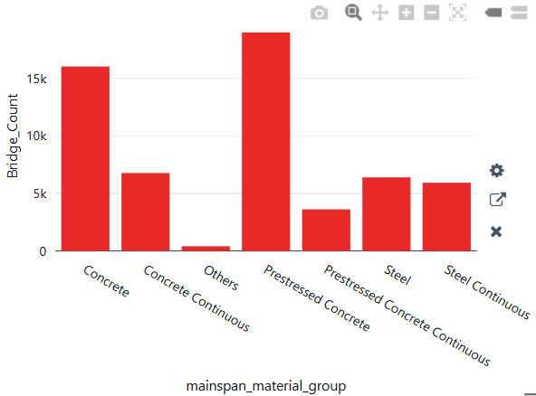
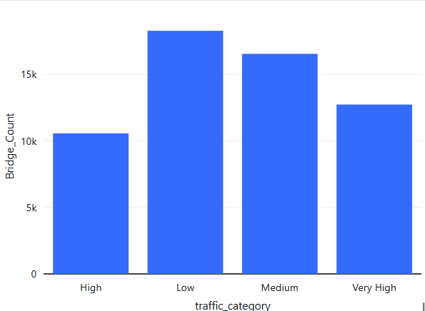
Distribution of Bridges by Main span Material
The Impact of Traffic Volume on Bridge Count

Slide 12
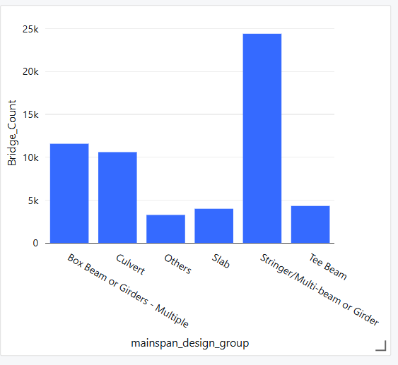
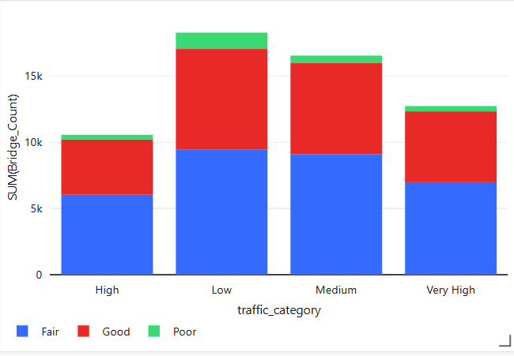
Distribution of Bridges by Main Span Design
Bridge Count by Traffic Volume and Condition

Slide 13
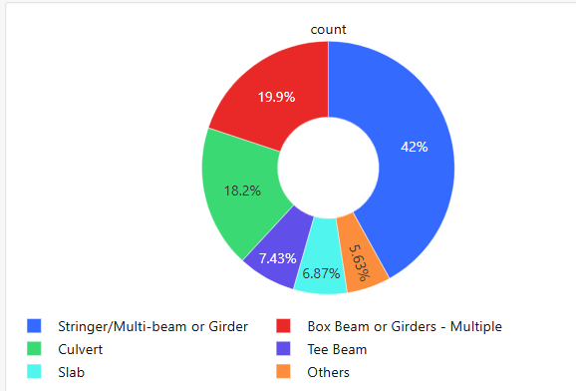
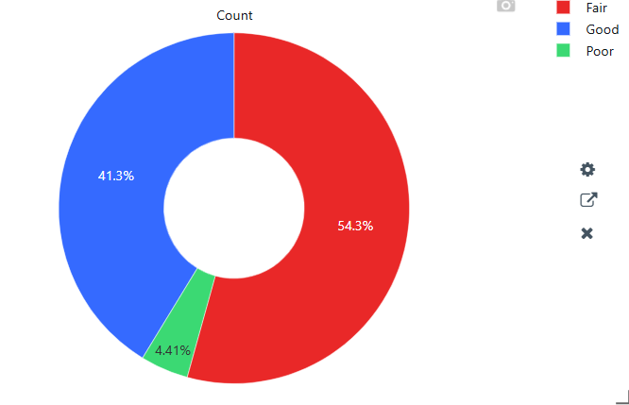
Percentage of Main span Design types of the bridges
Bridge Condition Distribution

Slide 14
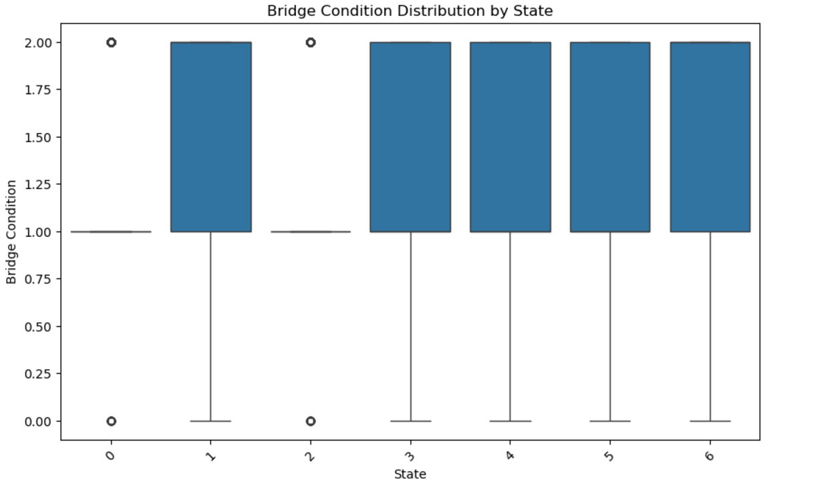
Bridge Condition Distribution by State
7 Different States
0-alabama
1-Illinois
2-Idaho
3-Connecticut
4-Texas
5-California
6-Pennsylvania

Slide 15
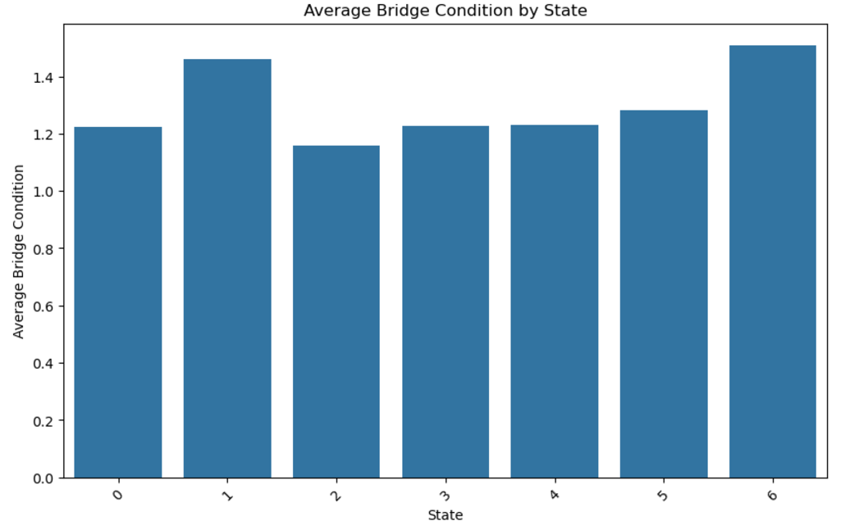
Average Bridge Condition by State
7 Different States
0-alabama
1-Illinois
2-Idaho
3-Connecticut
4-Texas
5-California
6-Pennsylvania

Slide 16
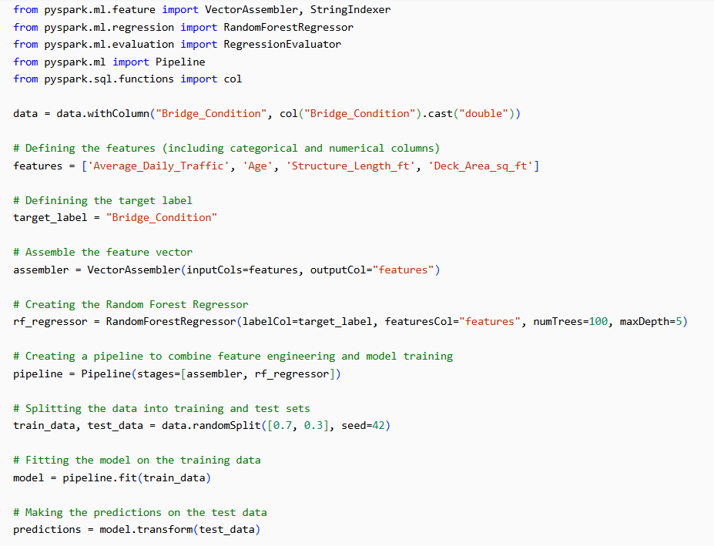
Random Forest Regression Model

Slide 17
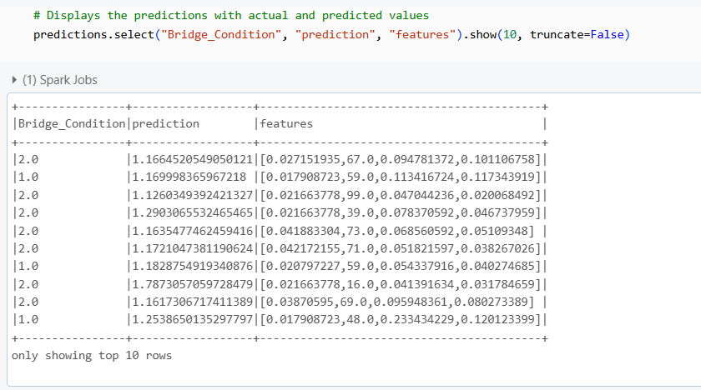

Slide 18
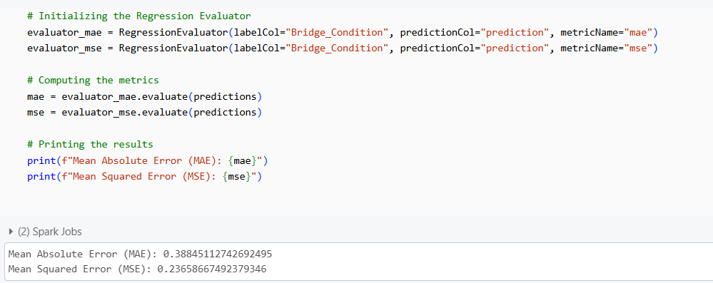
Evaluation Metrics:

Slide 19
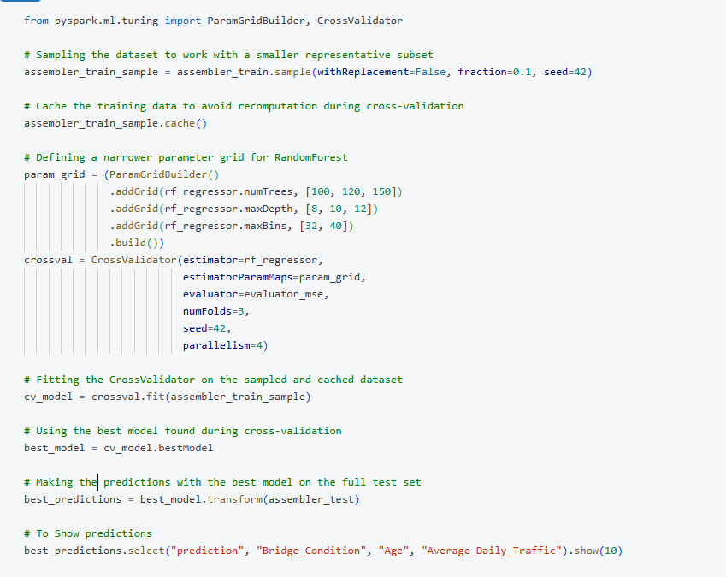
Cross Validation

Slide 20
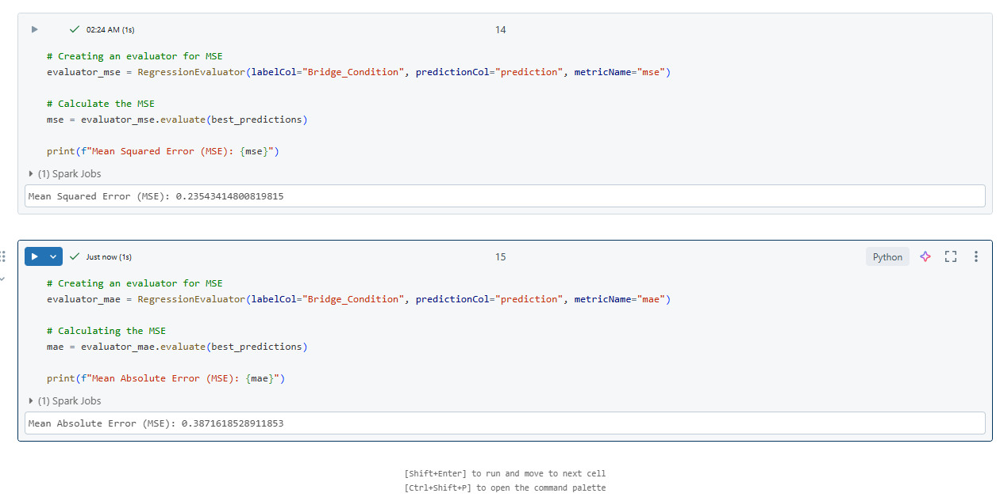

Slide 21
Conclusion:
The Random Forest Regression model was trained to predict the Bridge Condition based on a set of features.
First the model achieved a Mean Absolute Error (MAE) of 0.38845112742692495 and a Mean Squared Error (MSE) of 0.23658667492379346.
The model after doing the Cross Validation Mean Squared Error (MSE) is reduced to 0.2354 and Mean Absolute Error(MAE) reduced to 0.387
These results indicates that the model is capable of making reasonably accurate predictions for the Bridge Condition.

Slide 22
Future work:
To further improve the model's effectiveness, future work will involve gathering more data to enhance its accuracy.
Exploring advanced techniques like deep learning, integrating real-time sensor data for more up-to-date information.
Developing a user-friendly interface for easy use, collaborating with domain experts to ensure accuracy and relevance.
These combined efforts will contribute to creating a powerful tool for bridge maintenance and management.

Slide 23
References:
‌1. C. Tu, Y. Shi, D. Liu, W. Wang, and H. Ban, “Behavior and general design method of concrete-filled high-strength steel tube (CFHST) columns,” Engineering Structures, vol. 243, p. 112506, Sep. 2021, doi: https://doi.org/10.1016/j.engstruct.2021.112506.
2. P. Ziehl, T. Cousins, B. Ross, N. Huynh, and Carolina. Dept, “Assessment of Structural Degradation for Bridges and Culverts,” Bts.gov, Jun. 2020. https://rosap.ntl.bts.gov/view/dot/54525 (accessed Oct. 21, 2024).
3. GeeksforGeeks, “Introduction to Databricks,” GeeksforGeeks, Dec. 17, 2022. https://www.geeksforgeeks.org/introduction-to-databricks/ (accessed Oct. 21, 2024).
4. “Introduction to PySpark | Distributed Computing with Apache Spark,” GeeksforGeeks, Aug. 16, 2017. https://www.geeksforgeeks.org/introduction-pyspark-distributed-computing-apache-spark/

